Slide 1

Ph.D. Dissertation
Wednesday, April 7, 2021
Next-generation Network Control and Security
for the Internet of Things
George Violettas
Supervisor: Lefteris Mamatas

Slide 2
Presentation Outline
IoT challenges, problems
Aims and objectives of dissertation
Research & Proposed Solutions
RPL basics
1. End-to-end communication & mobility in RPL
2. Survey on RPL Security Issues
3. ASSET: Intrusion Detection System for IoT/RPL
Dissertation Contribution in a nutshell
Publications

Slide 3
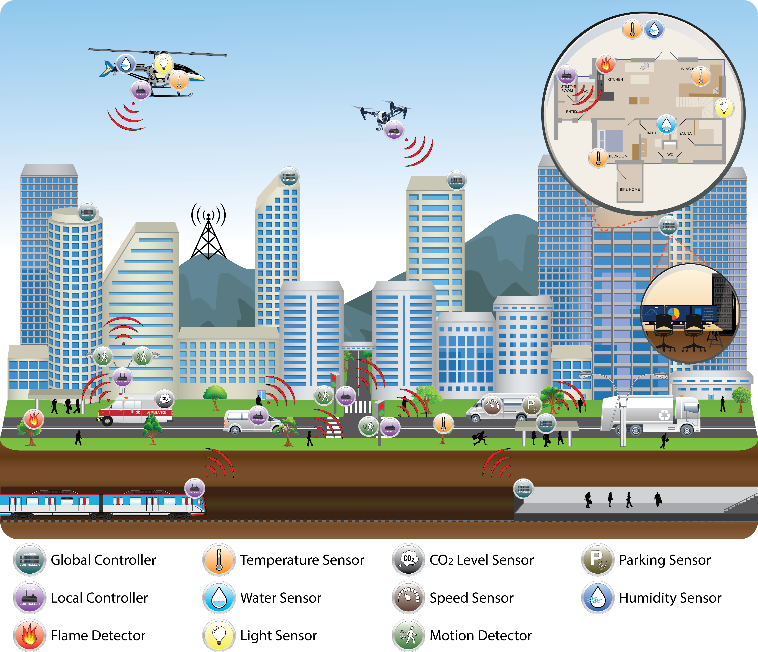
Internet of Things
One of the sectors with the biggest contribution to 5G is the Internet of Things (IoT)

Slide 4

Problems & Challenges in IoT
Constrained devices (memory, processing power)
Dynamic Topologies (mobile nodes)
Wireless Coverage Issues
Compatibility needed with existing protocols (IPv6, IEEE 802.15.4)
Security
Software and protocols problems and issues
Distributed network topology (RPL)
Multiple application communication patterns (many-to-one, one-to-one, etc.)

Slide 5
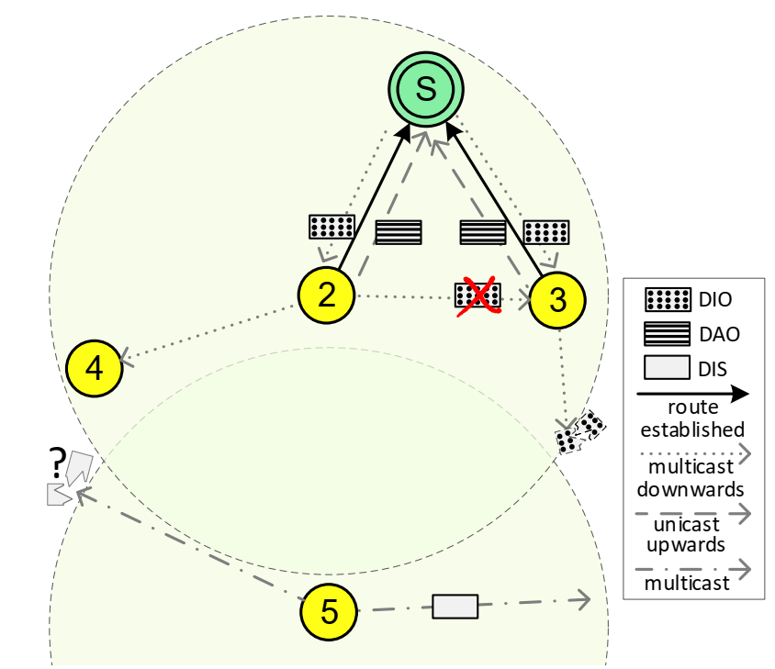
RPL Basics
RPL (Routing Protocol for Low-Power and Lossy Networks) is a routing protocol for wireless networks with low power consumption and susceptible to packet loss. It is a proactive protocol based on distance vectors, operating under IEEE 802.15.4and IPv6, optimized for multi-hop and many-to-one communication.
RPL creates a DAG (directed acyclic graph) to maintain the topology. Each node within the network maintains a rank from the sink (root) node. The nodes communicate with the sink via the "best" estimated path according to the Objective Function (OF) criteria.

Slide 6
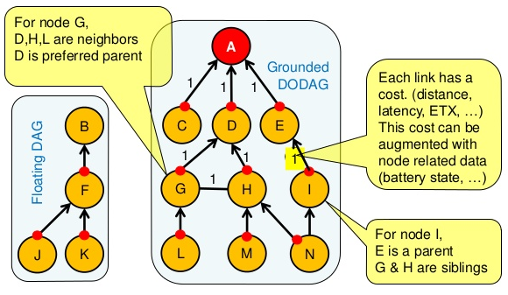
RPL: DODAG

Slide 7
Aims & Objectives
This dissertation aims to improve the end-to-end, mobility, and secure operation of the state-of-the-art RPL protocol with SDN-inspired architectures and mechanisms enabling a centralized elastic operation and intrusion detection, backed by node-level programmability and efficient control channel communication.

Slide 8

Research & Proposed Solutions
In several cases, protocol priorities need to be temporarily adjusted to serve an emerging need for point-to-point communication or aid mobile nodes to efficiently utilize the low available bandwidth.
  For such cases, targeted, tailored made solutions from the SDN paradigm were implemented & utilized.
Detailed literature review of Intrusion Detection Systems (IDS) for RPL protocol.
Construction of a state-of-the-art IDS (i.e., “ASSET”), inspired from the SDN paradigm.

Slide 9
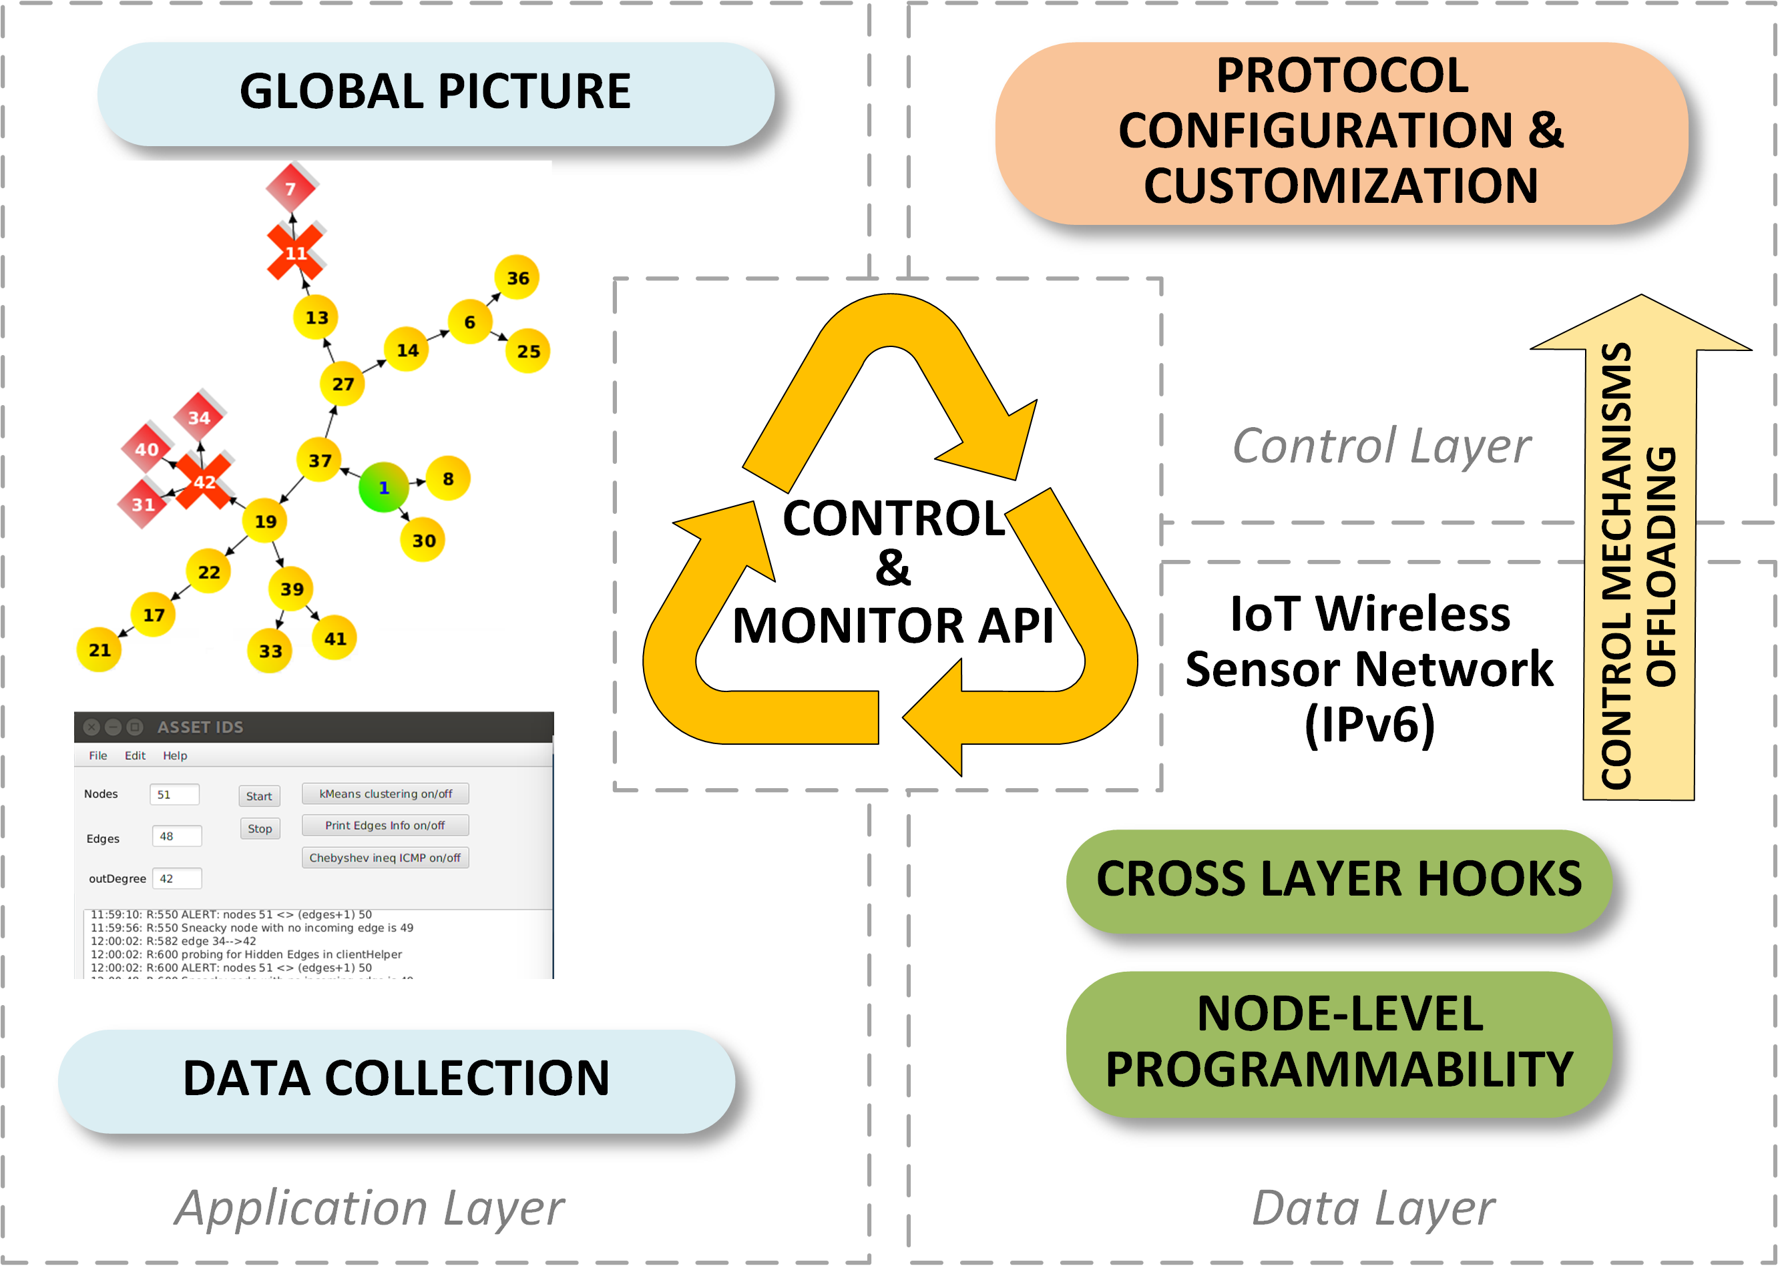
Abstract view of the architecture of SDN-like mechanisms implemented over IoT networks

Slide 10

DISSERTATION OUTCOMES

Slide 11
1. End-to-End Communications & Mobility for RPL
MOTIVATION
Complex IoT scenarios and applications involve mobility and communication beyond measurement collection from a single node, such as point-to-point (P2P).
Applicability boundaries of existing protocols’ solutions are not adequate.
  RPL topology maintenance features are particularly adjusted to energy efficiency and long-term periodic sensing over fixed motes’ deployment.

Slide 12
Contribution
Τhe high customization capability of the RPL protocol enabled SDN-inspired routing control strategies to extend the protocol’s applicability beyond typical WSN scenarios.
Τwo SDN-inspired network control mechanisms were proposed, improving the RPL’s behavior in mobile and P2P communication contexts, reflecting different depths in the protocol adaptation.
G. Violettas, S. Petridou, and L. Mamatas, ‘‘Evolutionary Software Defined
Networking-Inspired Routing Control Strategies for the Internet of Things,’’
in IEEE Access, vol. 7, pp. 132173-132192, 2019.

Slide 13
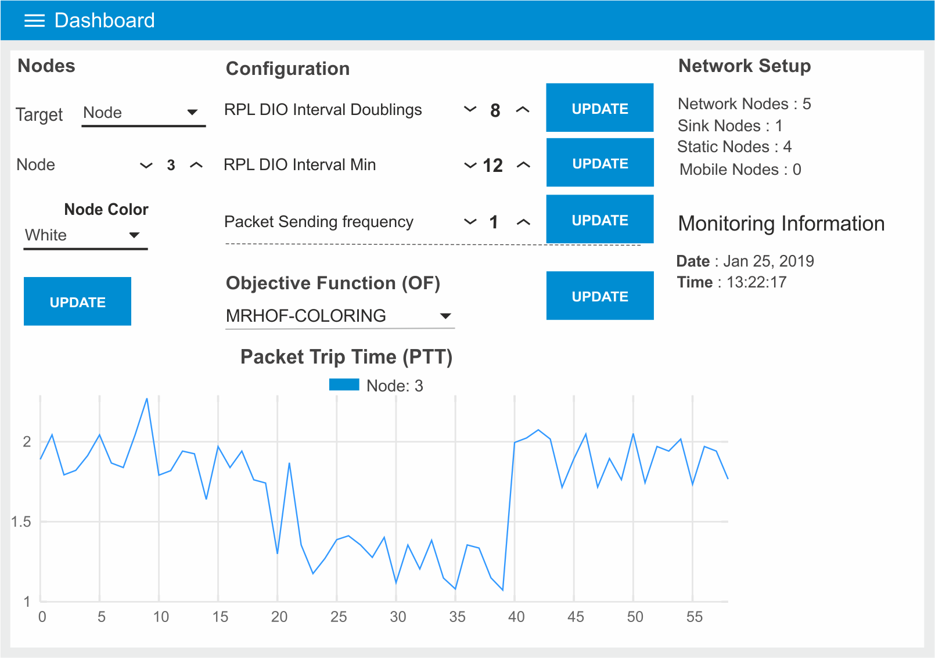
On-the-fly RPL configuration with the CORAL dashboard

Slide 14
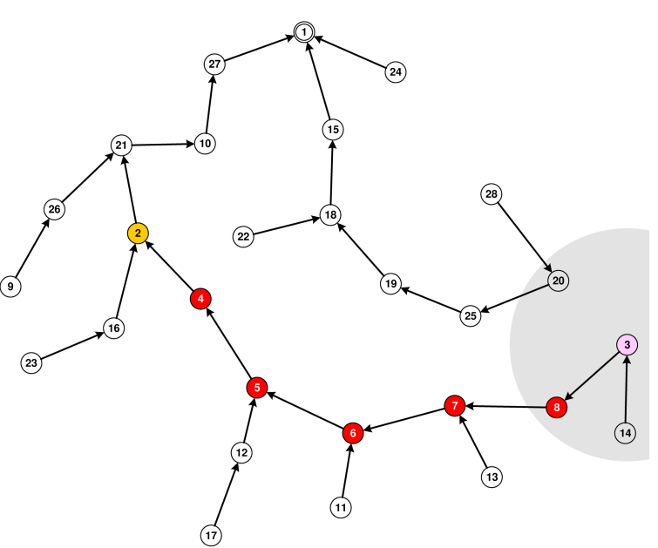
Custom Objective Function (OF)
Algorithm for point-to-point communication
Node-3 (purple) communicates directly with node-2 (yellow)
Originally, RPL is multipoint-to-point

Slide 15
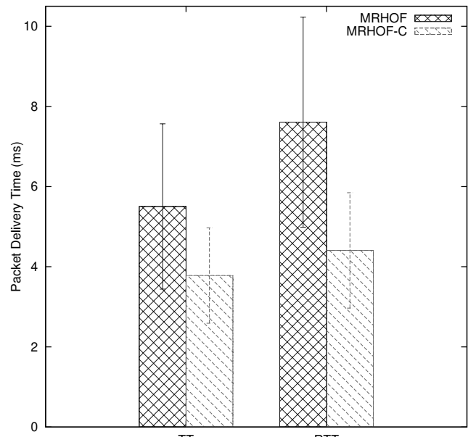
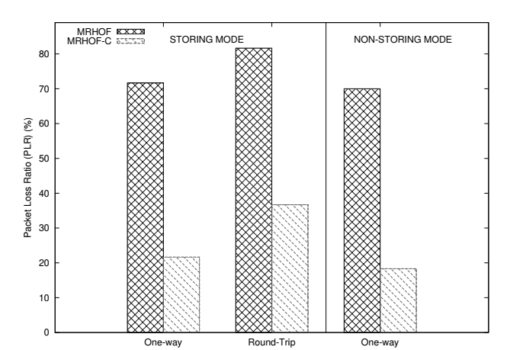
Custom OF
Packet Delivery Time Packet Loss Ratio

Slide 16

Conclusions
Such strategies improve the PDR (~33%) at the cost of increased control overhead.
Offloading this overhead to the fixed infrastructure can eliminate the impact and alleviate the network in emergency cases.
New Objective Function enables P2P communication, improving packet delivery time (~42%), reducing packet loss ratio (~75%), while keeping most of the rest network untouched.
Obvious cost of control overhead temporarily disturbs the network.

Slide 17
2. Survey on RPL Security Issues
MOTIVATION
RPL, based on the IPv6 open stack and using wireless communication has certain open security issues.
Majority of implementations assume unsecured mode of operation since security features are characterized as optional
  Only future versions will address authenticated security.
IoT networks suffer from the inability or the difficulty to tackle certain attacks inherited from the distributed, atomic mode of operation (missing centralized view).

Slide 18
Contribution
Up-to-date, systematic literature review on the RPL security issues.
Intrusion Detection Systems (IDS) successfully address the above:
  Categorization and analysis of such IDS characteristics
G. Simoglou, G. Violettas, S. Petridou, L. Mamatas, ‘‘Intrusion Detection Systems for RPL Security: A Comparative Analysis’’, Computers & Security, vol 104, pp. 0167-4048, Elsevier, 2021

Slide 19
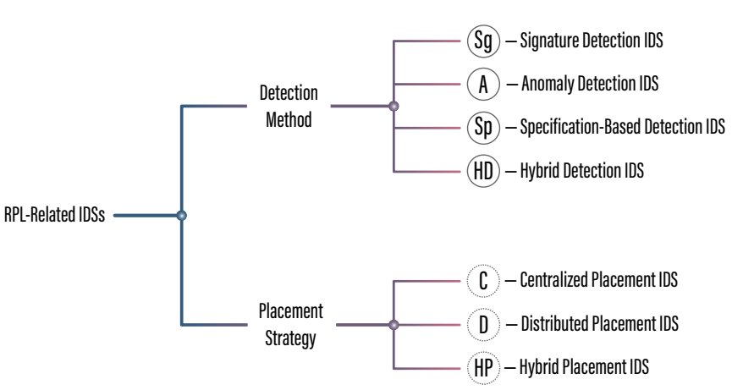
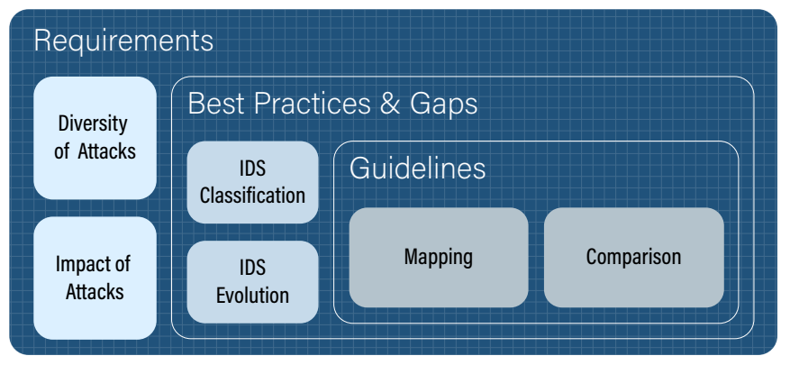
Analysis Details
Conceptual Framework constructed for the analysis
Classification of IDSs

Slide 20
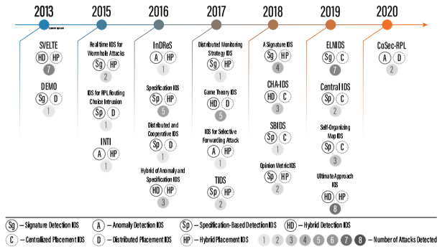
IDS Timeline

Slide 21
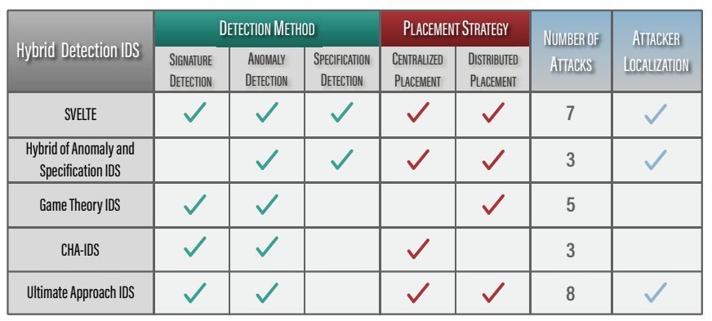
Hybrid Detection IDS Categorization

Slide 22
Conclusions
Investigated RPL attacks with special attention on control overhead and application performance impact
SUGGESTION: Holistic solutions are needed, with tailored-made characteristics, as network conditions and protocols’ mechanisms, handling mobility, respecting resource constraints, while providing high security (reflected in robustness and low false positives).
  Introduced seven design requirements and four guidelines that future RPL-related IDS should satisfy.

Slide 23
3. ASSET: Intrusion Detection System for IoT/RPL
MOTIVATION
RPL Security has several issues:
  Not implementing encrypted communications by default.
  Several features of the protocol (e.g., Local/Global repairs, Rank of nodes), and technologies (e.g., DODAG construction) can be exploited to create attacks and malicious activities disrupting or even ceasing proper operation.

Slide 24
Contribution
A state-of the-art, SDN-like, centralized infrastructure, tackling the above challenges.
The IDS is utilizing machine learning, artificial intelligence, and several modular mechanisms.
Enhancements in RPL to create catholic view of the network.
Monitors and identifies attacks, identifies and excludes the attacker if possible.
(Under Revision)
G. Violettas, G. Simoglou, S. Petridou, L. Mamatas, ‘‘ASSET: A Softwarized intruSion dEtection SysTem for RPL’’ , Future Generation Computer Systems, Elsevier, 2021.

Slide 25
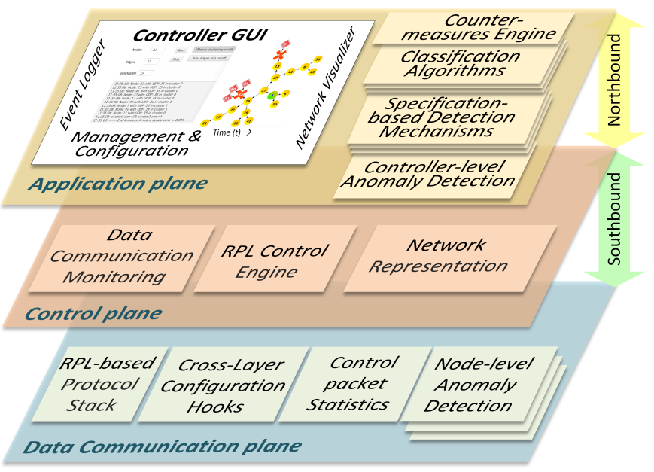
ASSET IDS
Centralized
SDN-like
Modular
3-tier architecture
Adaptable control channel

Slide 26
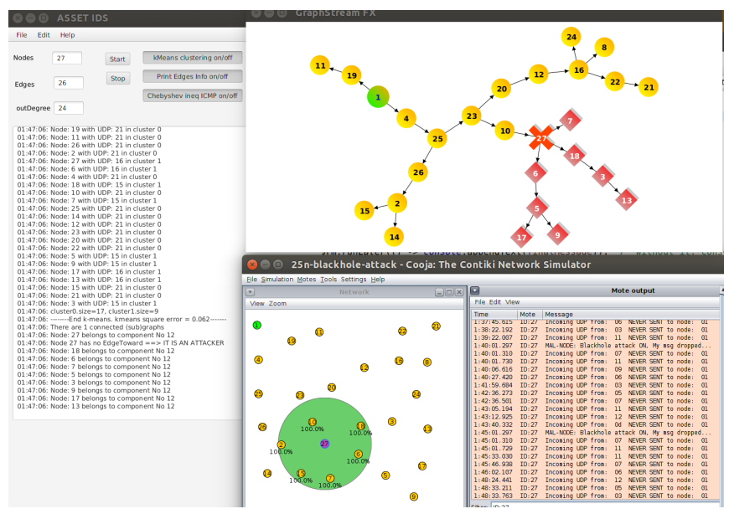
Attack detection, intruder identification, and attack mitigation

Slide 27
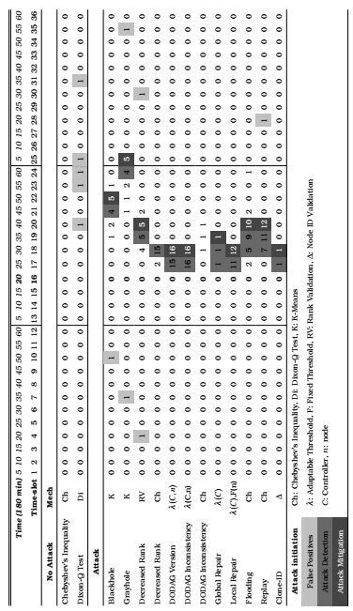

Slide 28
Conclusions
ASSET is an Intrusion Detection Softwarized controller for RPL.
Capable of detecting and mitigating 13 RPL-related attacks more than any other similar technology in the literature.
It is modular, and easily expandable.
It can be enriched to confront some attacks with bigger precision, and also to tackle newly emerged attacks.
Source code is freely distributed, to be utilized as a platform for future research by the scientific community.

Slide 29
Dissertation contribution in a nutshell
New, innovative ways of tackling the point-to-point communication and mobility weaknesses of RPL by utilizing custom-made algorithms complying with RPL, under the prism of selective network-softwarization.
New, adaptable, dynamic parameterization of RPL, depending on the given
network’s characteristics, by considering the catholic network view provided by utilizing the network-softwarization paradigm.
A detailed categorization and deep analysis of RPL’s security challenges, along with a detailed analysis of existing Intrusion Detection Systems for the same, and their characteristics.
A state-of-the-art SDN-like, centralized IDS for IoT-RPL networks, detecting and mitigating
more attacks than any other similar system in the literature; able to identify and ostracize the intruder in several cases.

Slide 30
Publications
JOURNALS
G. Violettas, S. Petridou and L. Mamatas, ‘‘Evolutionary Software Defined Networking-Inspired Routing Control Strategies for the Internet of Things,’’ in IEEE Access, vol. 7, pp. 132173-132192, 2019.
T. Theodorou, G. Violettas, P. Valsamas, S. Petridou, Lefteris Mamatas, ‘‘A Multi-Protocol Software-Defined Networking Solution for the Internet of Things,’’ IEEE Communications Magazine, vol. 57, no. 10, pp. 42-48, Oct. 2019.
G. Simoglou, G. Violettas, S. Petridou, L. Mamatas, ‘‘Intrusion Detection Systems for RPL Security: A Comparative Analysis’’, Computers & Security, vol 104, pp. 0167-4048, Elsevier, 2021.
(Under Revision) G. Violettas, G. Simoglou, S. Petridou, L. Mamatas, ‘‘ASSET: A Softwarized intruSion dEtection SysTem for RPL’’ , Future Generation Computer Systems, Elsevier, 2021.
CONFERENCES
Valsamas, P., Skaperas, S., Violettas, G., Theodorou, T., Petridou, S., Vardalis, D., & Mamatas, L. (2019). ‘‘Multi access edge computing for efficient content istribution and IoT services’’. In 2019 IEEE WCNC.
P. Valsamas, S. Skaperas, G. Violettas, T. Theodorou, S. Petridou, D. Vardalis, A. Tsioukas and L. Mamatas, "Experimenting with Cloud and Network Orchestration for Multi-Access Edge Computing", IEEE Wireless Communications and Networking Conference, Marrakech, Morocco, Apr. 2019, demo paper.
Violettas, G., Petridou, S., Mamatas L., ‘‘Routing under heterogeneity and mobility for the Internet of Things: a centralized control approach’’, IEEE Global Communications Conference, IEEE Globecom, 09-12 December 2018, Abu Dhabi, UAE. Acc. Rate 38%.
G. Violettas, T. Theodorou, S. Petridou, A. Tsioukas, and L. Mamatas, ‘‘An Experimentation Facility Enabling Flexible Network Control for the Internet of Things,’’ International Conference on Computer Communications – (INFOCOM), IEEE, Atlanta USA, May. 2017, demo paper.
TUTORIALS
Violettas, G., Theodorou, T., and Mamatas, L. (2017b). Softwarized IoT with Lightweight Clouds in Practice (3hr). (Berlin, Germany: 3rd IEEE Conference on Network Functions Virtualization and Software Defined Networking (IEEE NFV-SDN 2017), 2017.

Slide 31
Alea jacta est
Questions?

